Slide 1
Introduction to Wikimedia Technical Areas
Notes:
Hello everyone, I am Ujjwal ,one of the students selected in GSoC last year with Wikimedia Foundation.
How many of you know about GSoC ? Many.. Google Summer of Code is a global program focused on bringing more student developers into open source software development. Students work with an open source organization on a 3 month programming project during their summer break.
Some of the advantages of getting into GSoC -
You get one time referral for interviews at Google.
You learn how to develop a project professionally.
You get a chance to connect with awesome people (mentors and other developers).
Your resume becomes attractive that definitely helps you in good career.
You get 3000$ as stipend
Learn various latest technologies.
Above are few major advantages of getting into GSoC.
As I already mentioned I worked under WMF, I will like to share a glimpse about it. Before I go through it. I will like to know how many of you heard about Wikimedia Foundation ? Very less hands. Okay, I will make it easy for you. How many of you know about Wikipedia? Everyone! Well, Wikimedia Foundation is a non-profit organization based in San francisco that supports various projects and one of the most famous projects under it is Wikipedia. Now, I will be giving you a high level overview of technical areas in the Wikimedia Sphere in the coming slides.
======================================================================================
Hello everyone, I am Ujjwal Agarwal and I am one of the students selected in GSoC last year with WMF. This talk is a high level introduction of technical areas in WMF.
This hackfest
What do you know about Wikimedia.
Tell about Wikimedia's participation in GSoC.
Give a brief overview of Wikimedia.
Can someone just stand up and tell us something about it.
=================================
Introduction and welcome!
Overview of ten newcomer friendly areas in Wikimedia

Slide 2
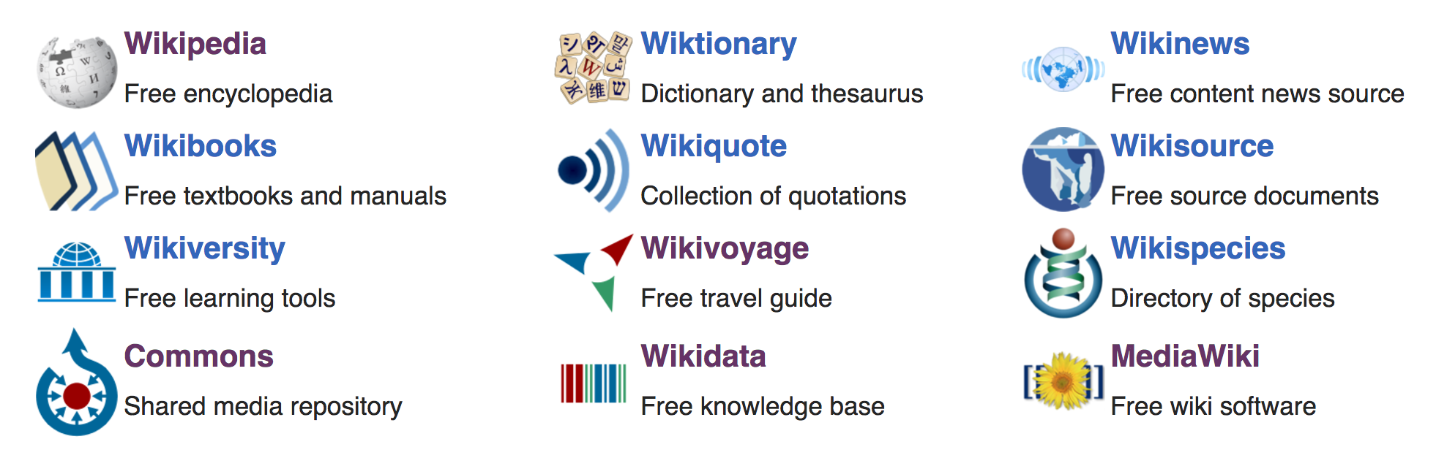
Wikimedia’s Mission and Projects
Wikimedia is a global movement whose mission is to bring free, multilingual, and educational content of its wiki-based projects to the world.
Notes:
Wikimedia envisions a world in which every single human being can freely share in the sum of all knowledge. And, it works towards this vision by empowering and engaging individuals to develop educational content and also spread it globally.
There are twelve projects that Wikimedia Foundation supports:
Wikipedia, you already know which is quite popular but then there are other projects which are popular in their own community
WikiVoyage is used by travellers. The free worldwide travel guide that you can edit.
Wikimedia Commons is a repository of free usable media files - audio, video other kinds of media files; mostly used by photographers
MediaWiki is the software behind Wikipedia and all its sister projects that you can see.
Then, Wikidata is another growing project which is a repository of data of all the Wikimedia sites.
Wikiversity consists of free learning tools quite commonly used by the educator community

Slide 3
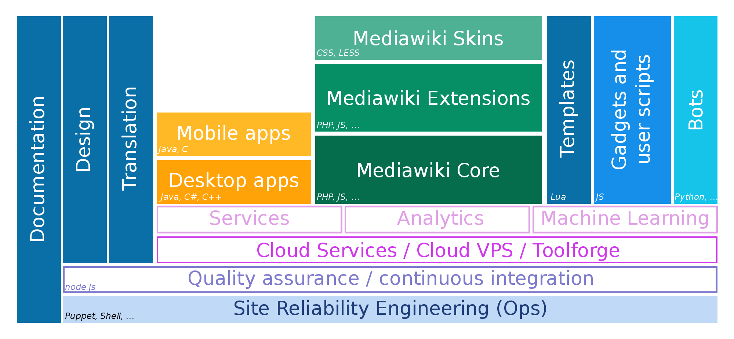
Wikimedia Technical Areas
CC BY-SA 3.0, Andre Klapper
Notes:
Alright, So these are some of the technical areas that I want to talk about and as I introduce you to the projects I will give you 1 example of a project that is related to an area, languages that you will need if you want to get involved.
I want to start with those areas first which we feel are suitable for newcomers and I will mostly recommend you going through those.
==================================================================
Here are some of the technical areas in Wikimedia.
Quickly highlight some areas -- for anything MediaWiki, you would need to be familiar with PHP, that is what the software is written in.
For apps, mobile or Desktop, depends for which OS you are developing, you would need Java, C, C, C++, Swift, etc
If you are writing your own tool / bot, you don’t need to stick to PhP and it could be Python, Node.js or whatever but not something that breaks our infrastructure :D
For gadgets or user script, pure javascript.

Slide 4
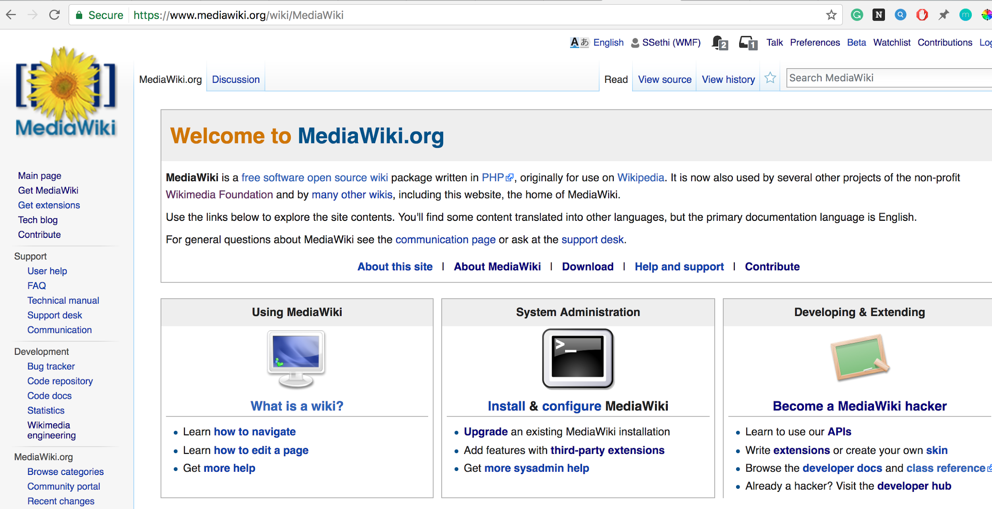

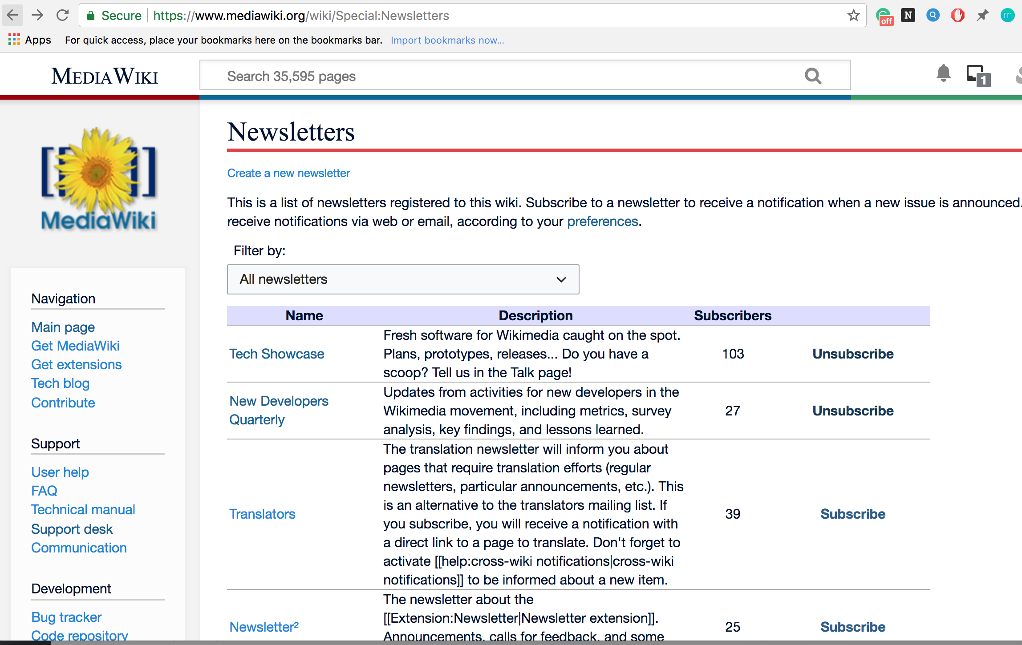
MediaWiki Extensions
What are extensions?
Extends the functionality of MediaWiki software
Extension:Newsletter
Allows creating, publishing and subscribing to newsletters on a topic of your interest
Skills required: PHP, Javascript
Screenshot of MediaWiki software
Screenshot of list of Newsletters available on MediaWiki
Notes:
So to start with, we have MediaWiki extensions -
Extensions basically extend the functionality of mediawiki software which is the core software that comes with basic functionality. and when I say MediaWiki I mean software you might have seen already that powers the content of Wikipedia and other Wiki Sites. Each extensions serves some kind of purpose. It's most recommended areas for newcomers to get started. You can help in 2 ways. Either you can help develop a completely new extension. or improve existing extensions. And for contributing to anything which is mediawiki related that I will share throughout my presentation you will need PHP, JQuery, JS, CSS/LESS, and MYSQL and MariaDB for Database Mang.
There are two examples of extensions that I would like to share:
Visual Editor was launched in 2012 and if you have edited the MediaWiki or any wiki site recently you might have interacted with this software. This is a WYSIWYG tool which supports editing as rich content. Whatever you type in, your changes appear in the same format as they would normally when you publish them. You could use various features of the Visual Editor tool to enhance your text such as make it bold, italic, or embed templates, media files, code snippets, format citations, etc.
Newsletter extension
To give you an example of an extension, lets see Echo, which provides a notification system that can be used by other extensions as well and what I mean by that is so if you have yoused Mediawiki, you might have noticed that you get a notification for all kinds of things, like when user rights are changed, (---) or when someone created a topic on your page. So for all the things we get notification, they gets handled by this extension.
===================================
MediaWiki core - do not start from here unless it is a small bug fix or typo
MediaWiki extensions. If you’ve installed the MediaWiki software before, you might know that the software itself comes with just the basic functionality. But, if you like to enhance the capabilities of this software then you can do so by integrating extensions with it. For newcomers, contributing to extensions or developing extensions is the most easy way to start contributing to Wikimedia.
There are around 60+ categories of extensions with somewhere between 150-200 extensions that are quite popular and being used on the Wikimedia sites.
There are two examples of extensions that I would like to share:
Visual Editor was launched in 2012 and if you have edited the MediaWiki or any wiki site recently you might have interacted with this software. This is a WYSIWYG tool which supports editing as rich content. Whatever you type in, your changes appear in the same format as they would normally when you publish them. You could use various features of the Visual Editor tool to enhance your text such as make it bold, italic, or embed templates, media files, code snippets, format citations, etc.
Newsletter extension

Slide 5
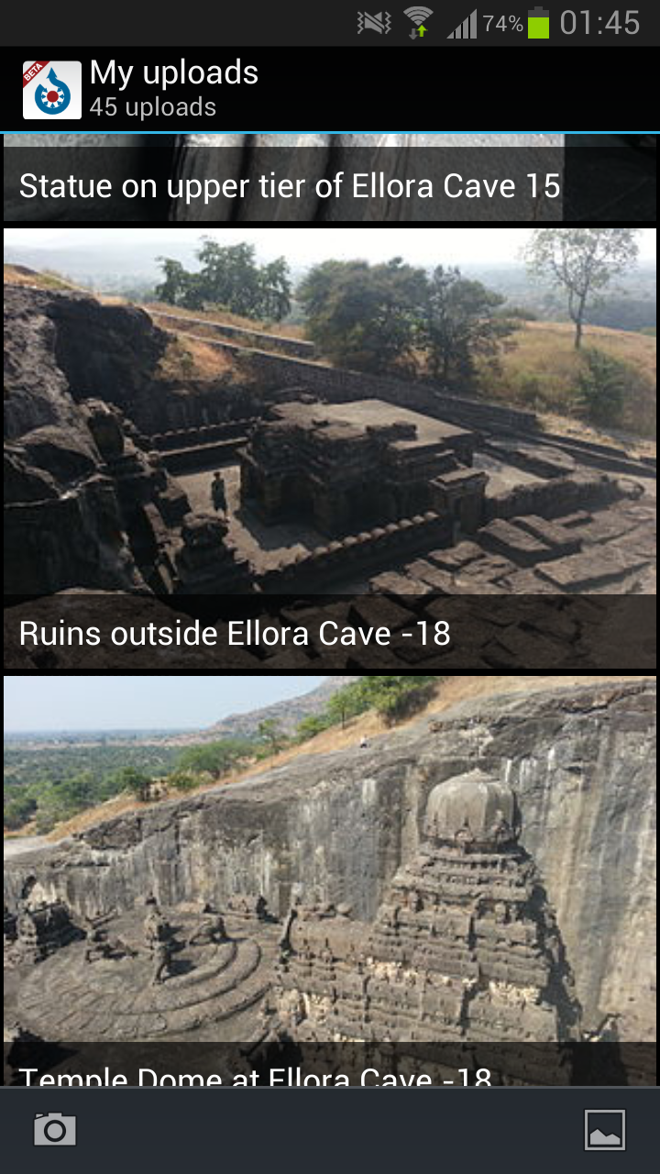
Mobile Apps
Available for Wikipedia and Wikimedia Commons
Wikimedia Commons App
Allows uploading pictures to Wikimedia Commons from Android
Skills required: Objective-C/Swift (IOS), Java (Android)
Commons app screenshot
CC BY-SA 3.0 Yuvipanda
Notes:
Then we have mobile apps which are available for Wikipedia and Wikimedia Commons. How many of you don't know what is Wikimedia Commons. So, Wikimedia Commons is a project which is run by WMF and it is a shared repository of free usable Multimedia Files - Images, Audio, Videos etc. and there is a mobile app as well which is maintained by community members. Using this app you can upload and browse pictures in Wikimedia Commons, and view nearby missing pictures. This is also a very newbiew friendly project.
and for mobile development you will need Objective C, Swift for iOS development and Java for Android.
=============================================================================
Mobile apps - The two most popular apps in the Wikimedia world are the apps for Wikipedia and Wikimedia Commons project.
I believe for Wikipedia we have apps both written for Android and IOS but for Wikimedia Commons it is only for Android as of now.
The newcomer friendly is Wikimedia Commons -- if you remember in the beginning i mentioned about Wikimedia Commons project.. So basically this app allows uploading media files from a smartphone.
To contribute to this project you would need Java. But, Objective-C, and Swift if you want to take a look at IOS apps.

Slide 6
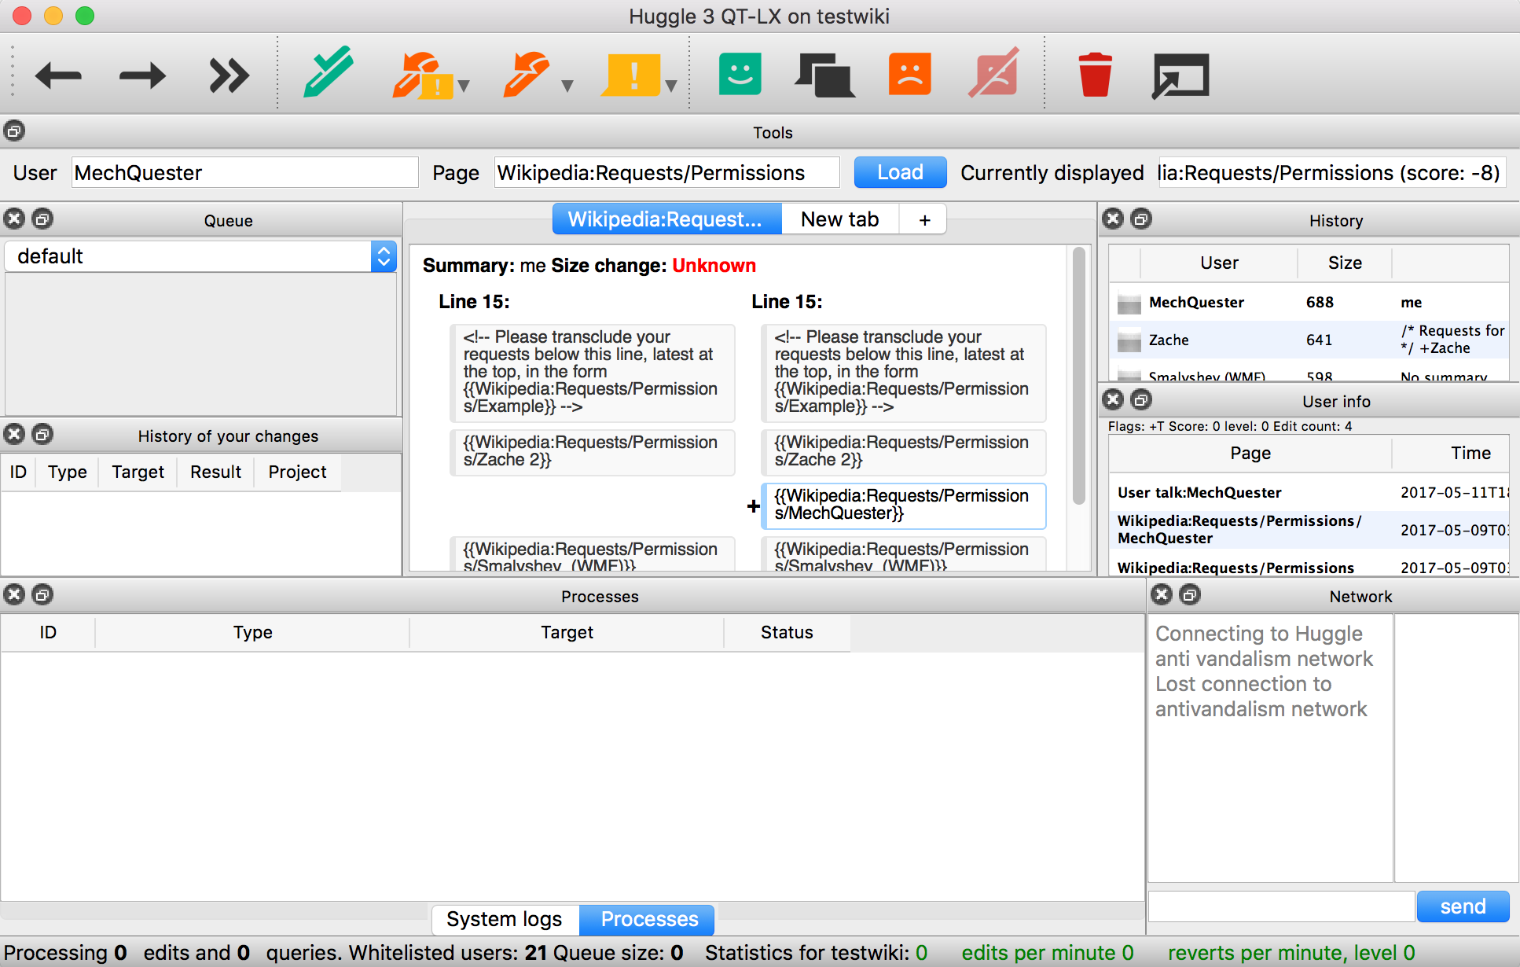
Desktop Apps
Huggle
An anti-vandalism tool that helps revert edits that are problematic
Skills required: C++ & Qt framework
Screenshot of desktop application Huggle
Notes:
Then we have desktop apps and example of 1 such app is huggle. It is an anti-vandalism tool which helps revert edits which are problamatic. Again a project that we think is suitable for new developers. For this you will need C++ and QT framework which is a cross-platform framework and GUI framework based on C++ so you will need skills like that.
=================================
Desktop apps. There are some desktop apps in the Wikimedia; but not that many.
Example of Desktop app - Huggle is a tool that allows moderators who review edits on articles to review the edits that are problematic. Not everyone can use this tool, only those who have specific administrative permissions on a wiki. So, this tool can be downloaded on the machine, and then you can load specific revisions in the software and then scroll through the differences between the revisions, and then revert the ones that are bad.
There are many ways of course to prevent an article from vandalism and this is one such way through huggle.
To work on the Huggle tool, you would need to be familiar with C++ and Qt framework. Qt is a graphical user interface toolkit for C++ that lets you design interfaces quickly.

Slide 7

Machine Learning
Objective Revision Evaluation Service (ORES)
Machine learning web service & API, allows scoring and evaluating an edit
Skills required: HTML, JS, CSS, Python, Redis, Postgres, Python Scikit-learn, PHP (MediaWiki), MariaDB
More info:
https://www.mediawiki.org/wiki/ORES
CC BY-SA 4.0, Mun May Tee
Notes:
Then there is also an area which is Machine Learning and ORES. It is an web service and API that allows to score an edit and help evaluate in a sense that whether an edit made on a wiki is a bad quality edit or a good quality edit. These are the skills required for this project. There is also an ORES extension so if you will need same skills - PHP, ..

Slide 8

Cloud Services
Empowers the work of technical contributors
Provides a hosting environment for running bots and tools
Support the operation, creation, and maintenance of these tools
1000+ tools hosted via these services
CC BY-SA 4.0, Brandon Harris
Notes:
Cloud Services is a computing ecosystem built on top of OpenStack, GridEngine and Kubernetes. These services are supported by Wikimedia Foundation staff and volunteer developers. They empower the work of technical contributors by providing them resources like a hosting environment called Toolforge for their tools, and bots. Not only that, they help them support the creation, operation and maintenance of these bots. And, this is for contributors who are planning on working on a project that would impact the Wikimedia ecosystem. There are about 1000+ tools that have been hosted via these services. So there are two ways you can contribute in this area: one is that you get in touch with their team and see if they need any help with documentation, or learn from them how to host a tool if you already have built one at the hackathon, or learn ways that you can contribute to their existing infrastructure.

Slide 9
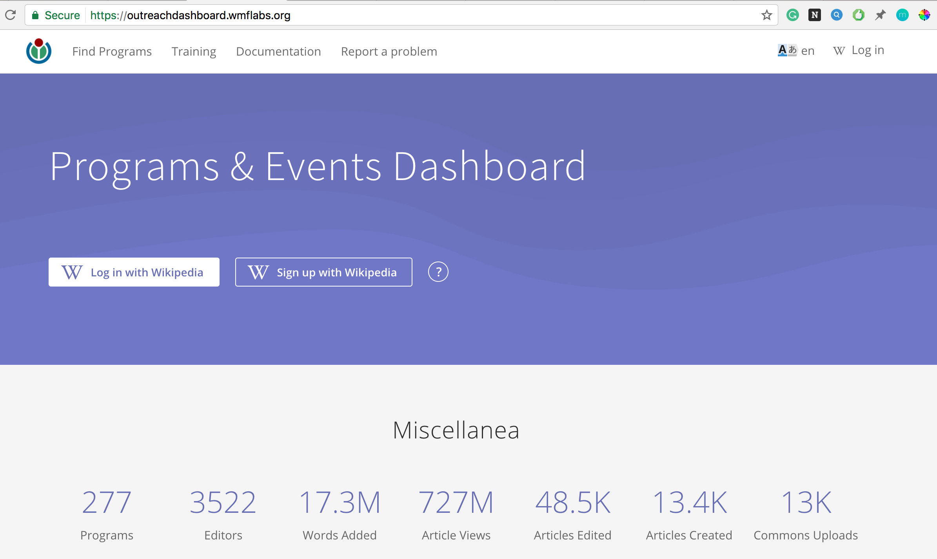
Cloud Services
Wiki Edu Dashboard
Web application that supports course instructors in running training and event organizers in edit-a-thons around Wikipedia
Skills required: Ruby on Rails, JavaScript, React.js and Redux, User interface design, etc
Screenshot of WikiEd’s Program and Events Dashboard
Notes:
Second is this -- you can contribute to projects that already hosted on Cloud Services infra. One such example is the WikiEdu project which is used by event organizers to run editathons around Wikipedia and by course instructors to teach courses around Wikipedia. This tool helps them in content sharing, managing running events and courses and also in generating some cool statistics like how many people edited Wikipedia, words they added, new articles created, etc. Skills required would be Ruby on Rails.

Slide 10
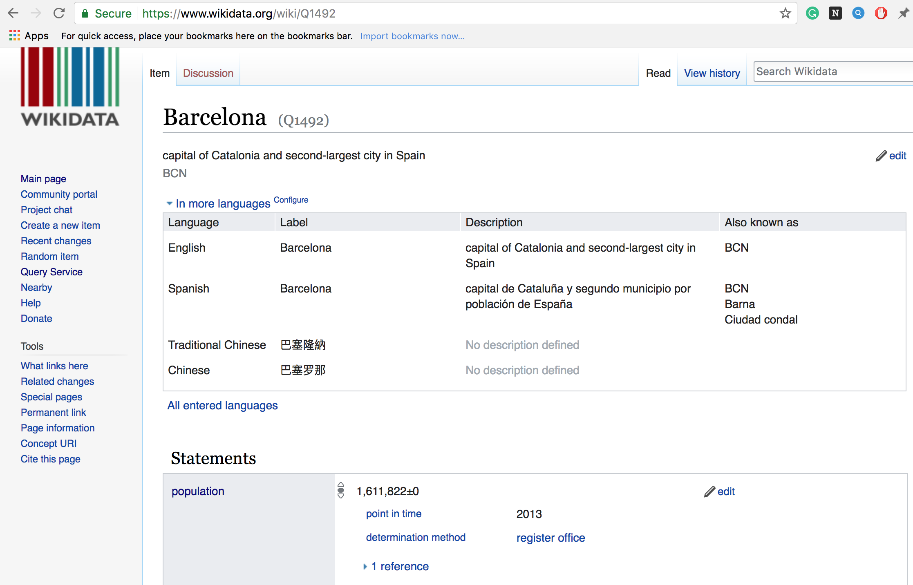
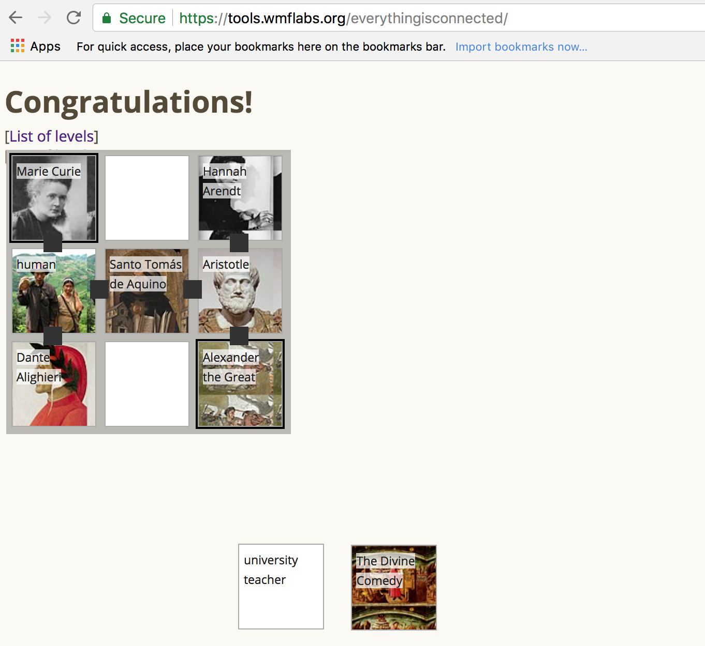
Structured Data
What is Structured Data?
Organization of data in a structured format that makes data easily editable, searchable and re-usable
Wikidata
Central repository of structured data for all Wikimedia sites
Skills required: PHP, Javascript
Screenshot of Wikidata item on Barcelona
Screenshot of Wikidata puzzle game
Notes:
Structured data - Structured data is a fairly new emerging technical area in Wikimedia. It refers to the organization of data in a structured format so that it becomes easy to use it, modify and search data.
An example of this technical area is Wikidata - quite popular project which is a central repository of data of all Wikimedia sites. To understand the powers of Wikidata; let me give you an example.
There might be an entry on the city Cape Town in Wikidata. Now each data item has properties that tells us a bit more about the data. For example, if it is a city, then the fields would be languages spoken, population, website, images, government etc. Now, if we talk about some of the changing properties; then population should be the number one on the list, right. So, if let say there are a number of articles across wikis that has this information on it; population of Delhi which changes every year. So, then is you are embedding this data straight from Wikidata on an article, then every time it changes, you need to make the change on Wikidata and the rest will receive an update automatically.
So, again there are lot of way to contribute to Wikidata. You can use Wikidata’s data plus the Web APIs to build games, lots of people have developed game; the one on this slide is a puzzle game and there are others...

Slide 11
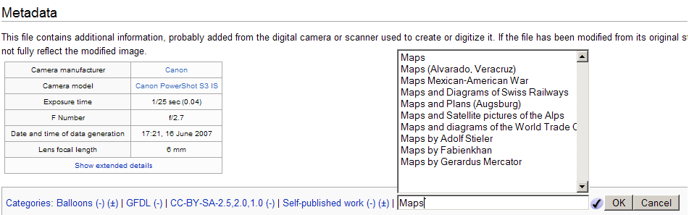
Gadgets and User scripts
What are Gadgets?
Standard, on-wiki user scripts that extend the functionality of MediaWiki
HotCat
Helps registered users easily remove, change, and add categories to Wikipedia pages
Screenshot of Gadget: HotCat
Notes:
Gadgets and user scripts - now I first want to talk about user scripts. User scripts from the name itself is clear that users can write to enhance the capability of Wiki for their own need. Now an example of that would be -- for example you want to display on every article of a wiki how much time you would take to read it; so you can write a little script - the way to do so is by creating a subpage of your user page on a Wiki and then save it with common.js.
Now, anytime user script seems to be useful for the broader community, then an administrator can promote it and make it a gadget. Now an example of a gadget would be navigation popups - which is now available as an extension called PagePreviews. Now, how they work - so anytime you hover over on links on an article on a wiki; then you see a little popup which gives you a preview of what the page is about.
The difference between gadgets and extensions is that the code for Gadget lives on wiki but for extensions elsewhere and that’s what make it difference; but basically they both do the same thing.

Slide 12
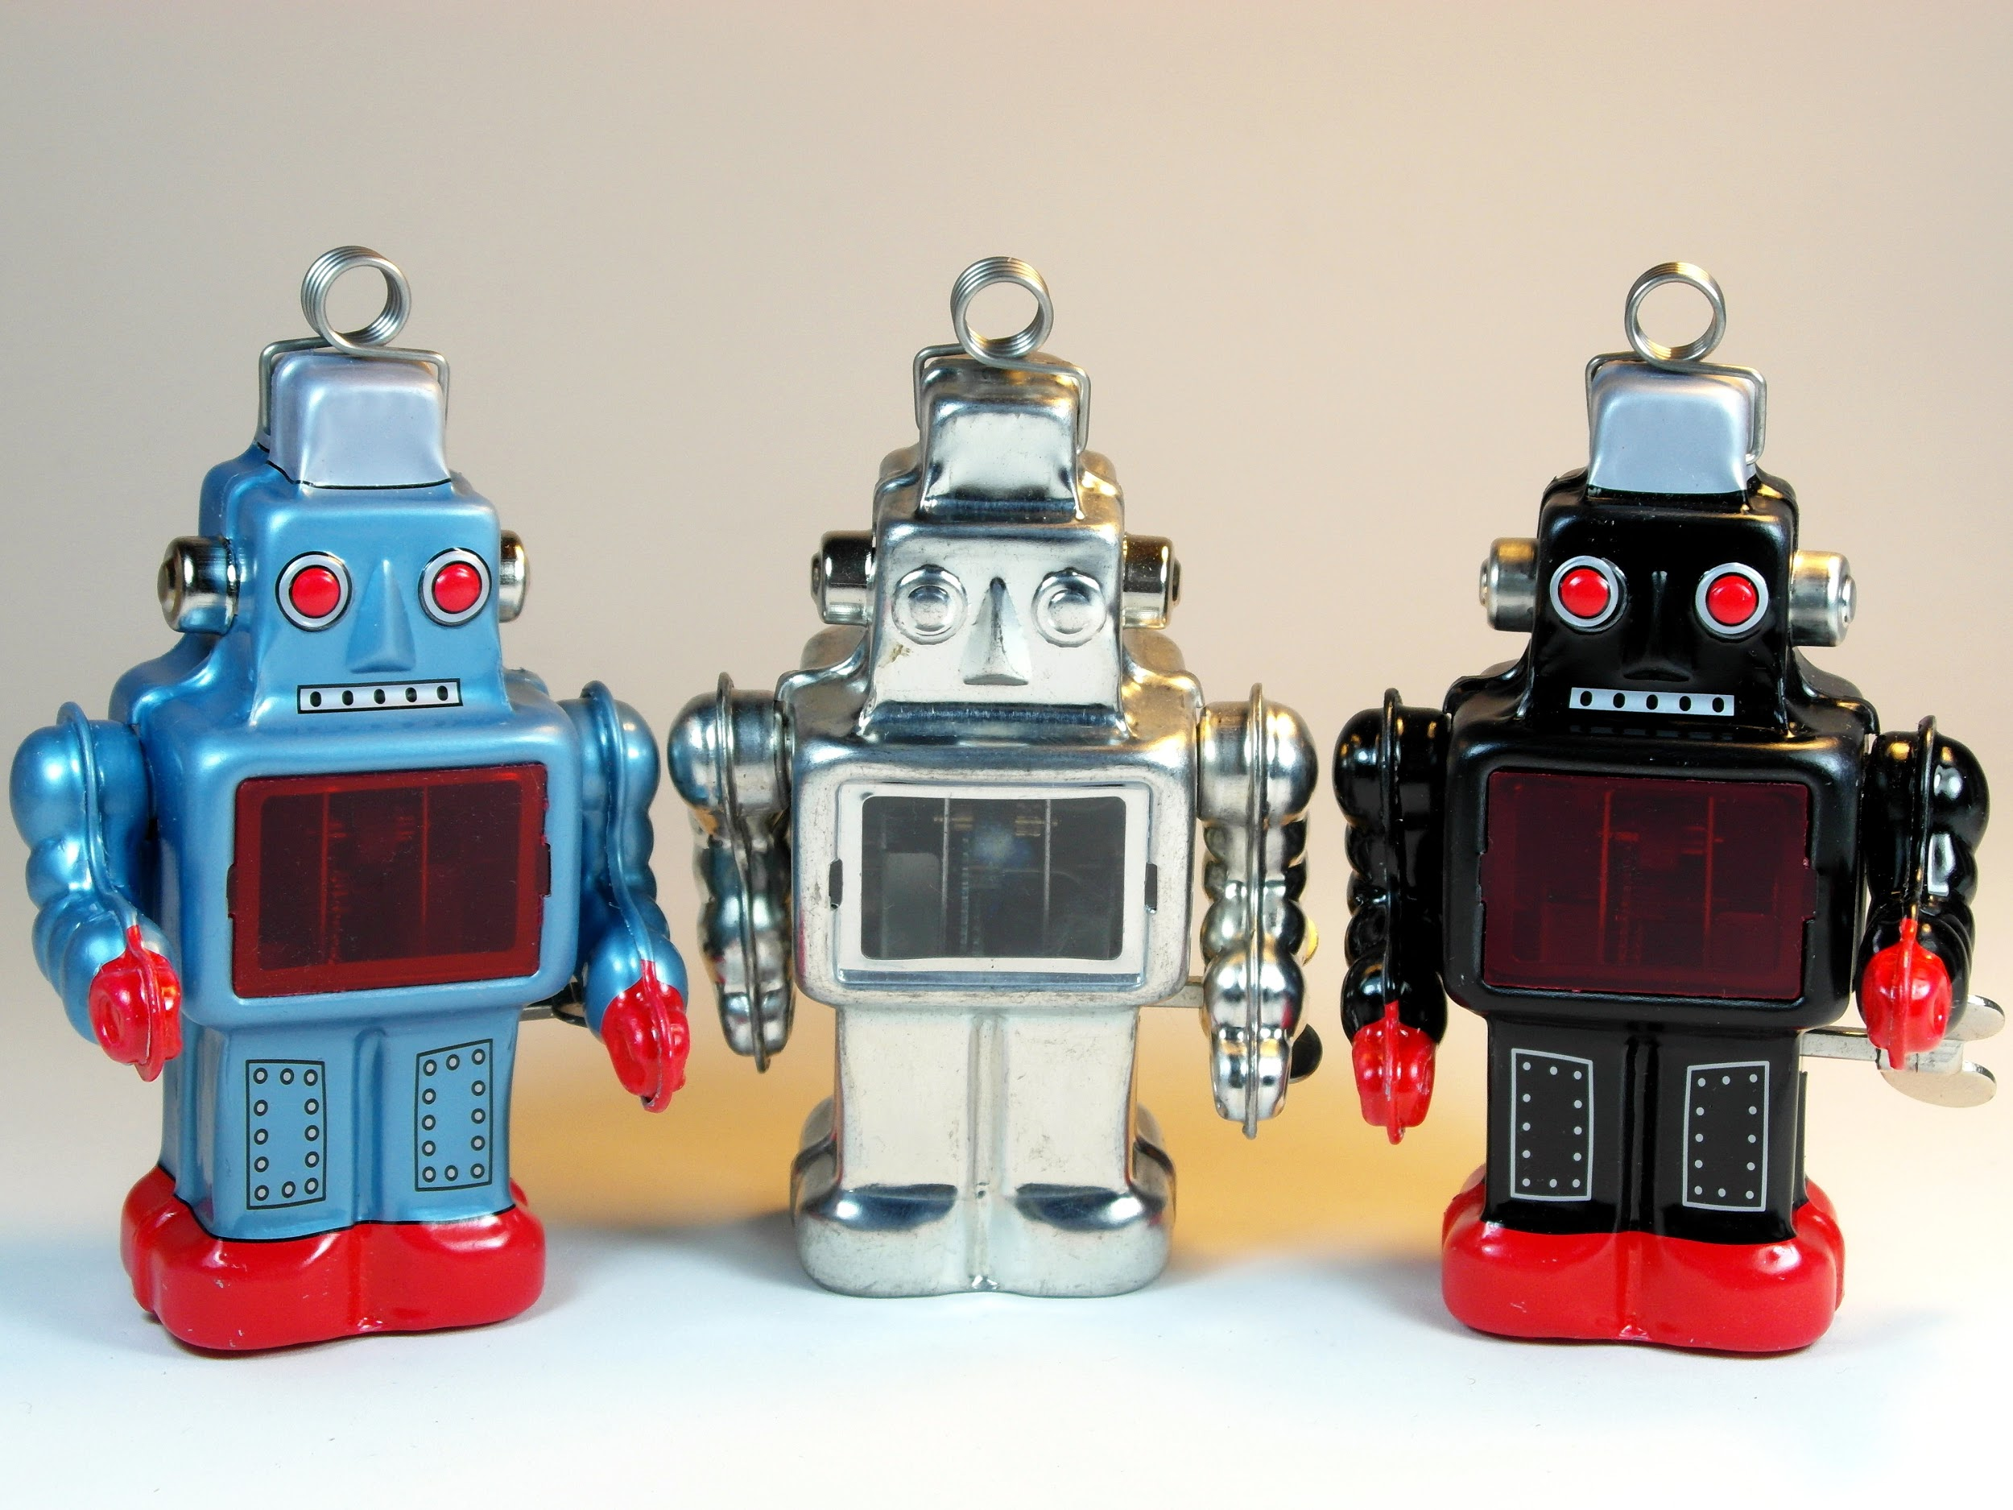
Bots
Automated tools that help perform tedious or repetitive tasks related to a wiki (e.g. spell check, revert vandalism)
Skills required: Familiarity with Python and Pywikibot
More info:
https://www.mediawiki.org/wiki/Manual:Bots

Slide 13
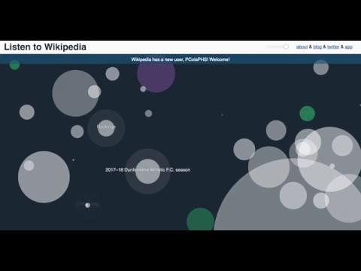
Analytics
Use data from Wikimedia sites along with our Web and REST API’s to create visualizations, make data informed decisions and have fun!
More info: https://wikitech.wikimedia.org/wiki/Analytics
Listen to Wikipedia >
Notes:
Talk about MediaWiki Action API

Slide 14
Design, Documentation, Translation & Quality Assurance
Help apply Wikimedia design principles in projects looking for UX feedback (design)
If you are fluent in a language other than English you can join the effort by translating MediaWiki site and the software (translation)
Help improve user/technical documentation on Wikidata, Cloud Services, MediaWiki, and other projects (documentation)
Help write tests in Javascript / Node.js (quality assurance)

Slide 15




Outreach Programs

Slide 16
Resources
How to contribute https://www.mediawiki.org/wiki/How_to_contribute
New Developers https://www.mediawiki.org/wiki/New_Developers
Notes:
Some of the areas highlighted in these slides are in the “How to contribute” guide
New developers guide
GSoC / Outreachy - Wikimedia Zulip

Slide 17
Thank you!

Slide 18





Confused about the differences between Wikipedia, Wikimedia, MediaWiki and Wiki?
WIKIMEDIA
MOVEMENT
WIKI
Notes:
==================================================================
How many people are clear on the differences between Wikipedia, Wikimedia, MediaWiki, Wikimedia movement and Wiki?
Let me try to clarify things a bit here:
Wikipedia-Encyclopedia-300 languages- 40 million articles - 2 edits per sec.
Mediawiki - software behind wikipedia.
Wiki - software - concept of quick collaboratively editing online.
Wikimedia movement - Community, values, activities of all people
========================================================================================
How many people are clear on the differences between Wikipedia, Wikimedia, MediaWiki, Wikimedia movement and Wiki?
Let me try to clarify things a bit here:
Wikipedia as you all may know is the largest encyclopedia in the world and also one of the biggest and popular project in the Wikimedia movement. Some of the cool facts:
There are articles written in over 300 languages.
In English language Wikipedia, there are more than 40 million articles.
Wikipedia gets developed at the rate of two edits made per second.
MediaWiki is the software behind Wikipedia and all its sister projects that you will hear shortly.
Wiki is the first software that introduced this concept of quick collaboratively editing online that you see in Wikipedia and similar projects. It is a “Hawaain” word meaning quick.
Wikimedia movement represents comprises of all kinds of people that make our community: editors, developers, researchers who are actively contributing and promoting project in the Wikimedia world.
Wikimedia Foundation is a non-profit organization based in San francisco that supports Wikimedia projects and all movement wide activities in various ways.

